Slide 1
Final Thesis
Suitability of Modern Wi-Fi for Wireless Infield-Communication
Karl Lautenschläger
Notes:
My Name is
I'm studying Information System Engineering in my kind of Masters at the TU Dresden
Start final thesis in November
14
1/25/23

Slide 2
Agenda
Motivation Final Thesis
Physical Layer Technologies
Field Measurements
Simulation Experiments

Slide 3
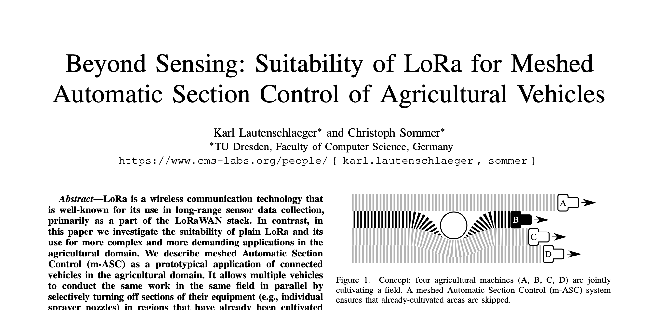
Background
December 2020 – April 2021: Undergraduate thesis about Suitability of LoRa for Meshed Automatic Section Control of Agricultural Vehicles
<number>
Notes:
<number>

Slide 4
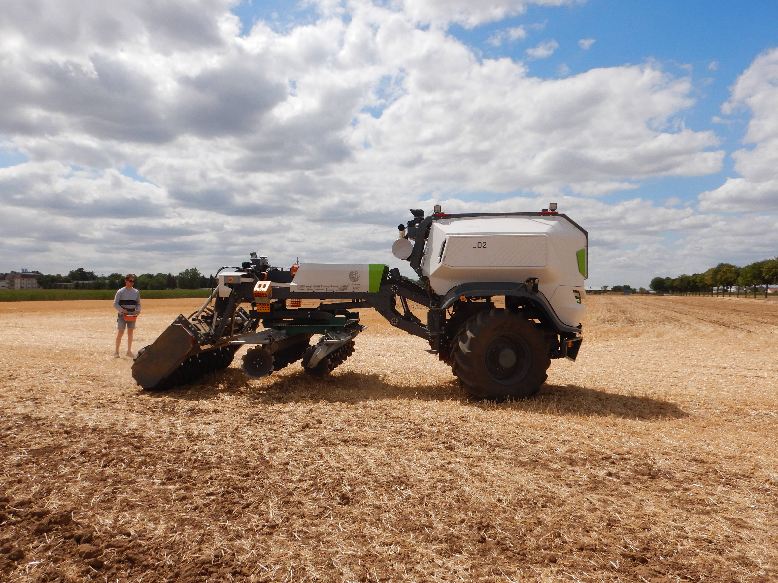
Background
March 2022 – August 2022: Intern at the Feldscharm project
<number>
Notes:
<number>

Slide 5
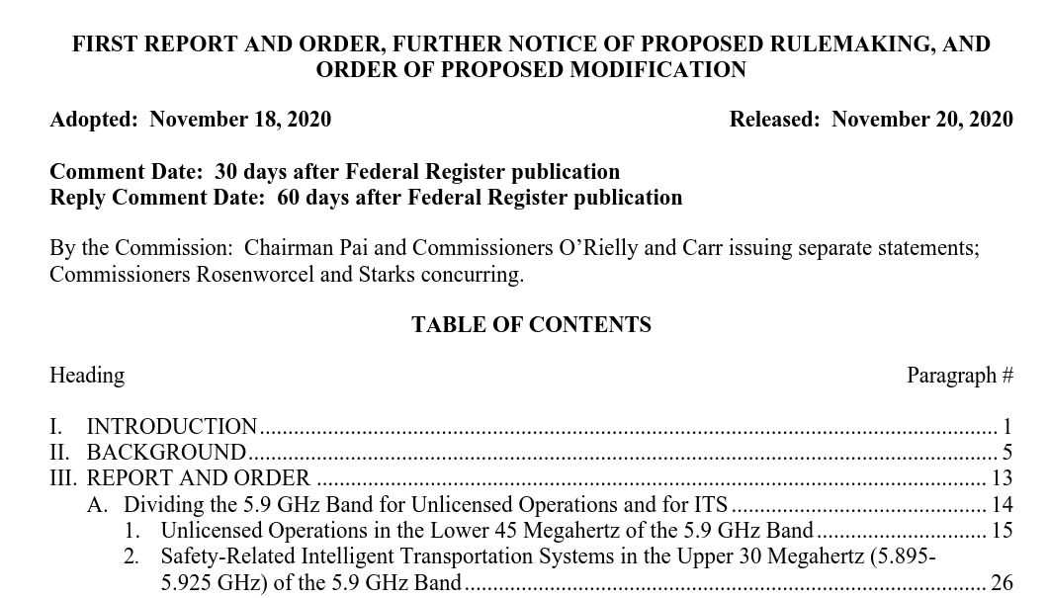
Motivation Final Thesis
Notes:
Johann mentioned
No infrastructure
802.11p very promissing
FCC regulation no dedicated spectrum anymore
Alternatives?
Modern Wi-Fi

Slide 6
Modern Wi-Fi
 | IEEE 802.11ac (Wi-Fi 5) | IEEE 802.11ax (Wi-Fi 6)
Spectrum | 5 GHz | 2.4 GHz, 5 GHz
Bandwidth | Up to 160 MHz | Up to 40 Mhz (2.4 GHz), 160 Mhz at 5 GHz
OFDM Guard Interval | 0.4 or 0.8 μs | 0.8, 1.6 or 3.2 μs
Maximal Data Rate | 6.9 Gbit/s | 9.6 Gbit/s
Max Modulation Coding Scheme | 256-QAM | 1024-QAM
Multi-User Technology | MU-MIMO | MU-MIMO, OFDMA
Multi-User Transmission Direction | Downlink | Downlink und Uplink
K. Lautenschlaeger, Suitability of Modern Wi-Fi for Wireless Infield-Communication
<number>
Notes:
Of course better Data Rate
Multi user? Stadium
Because when to many people want to
But Amendments for improving outdoor communication
But indoor and outdoor range in the agriculture domain is unknown
<number>

Slide 7
Physical Layer Technologies

Slide 8
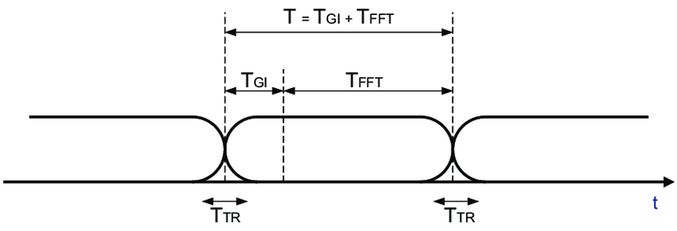
OFDM Guard Interval
Wi-Fi Standard | OFDM Guard Interval | Bandwidth attenuation = 100 * T_{FFT} / T [%]
Wi-Fi 4 & 5 | 400 ns | 89 %
Wi-Fi 4 & 5 | 800 ns | 80 %
Wi-Fi 6 | 800 ns | 94 %
Wi-Fi 6 | 1600 ns | 89 %
Wi-Fi 6 | 3200 ns | 80 %
Notes:
OFDM
Symbol to
Introduce a more resilitient possibilty against
Multipath effect
Inter Symbol Interference
Inter carrier interference

Slide 9
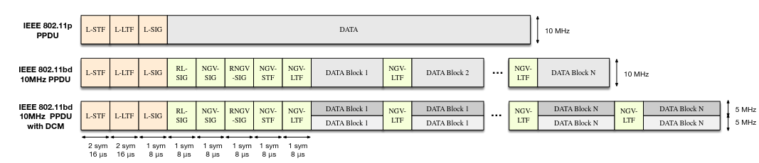
Dual Carrier Modulation (DCM)
Notes:
Transmit redundant copies of data via different subcarriers.
combined
Maximum likelyhood functions to
Lose Data rate Possible for 802.11 ax and bd

Slide 10
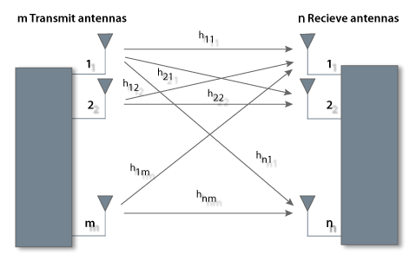
Multiple Input Multiple Output (MIMO)
Notes:
SI SO
Spatial multiplexing
Receive each mimo stream
Twice the data
4 MIMO Streams in Wi-Fi 4
8 MIMO Streams in Wi-Fi 8
But I can also use it to gain signal quality
Since Wifi 4

Slide 11
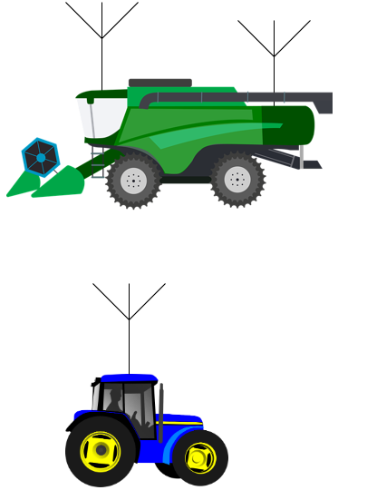
Space-Time-Block-Codes
Increases robustness
Decreases data date
Notes:
Spatial Diversity
Send redundant data copies via different MIMO streams received at the receiver combine
High Quality signal
802.11a
Same Throughput higher SNR or even same SNR and higher throughbut by using different modulation coding schemes
Possible since WiFi 4

Slide 12
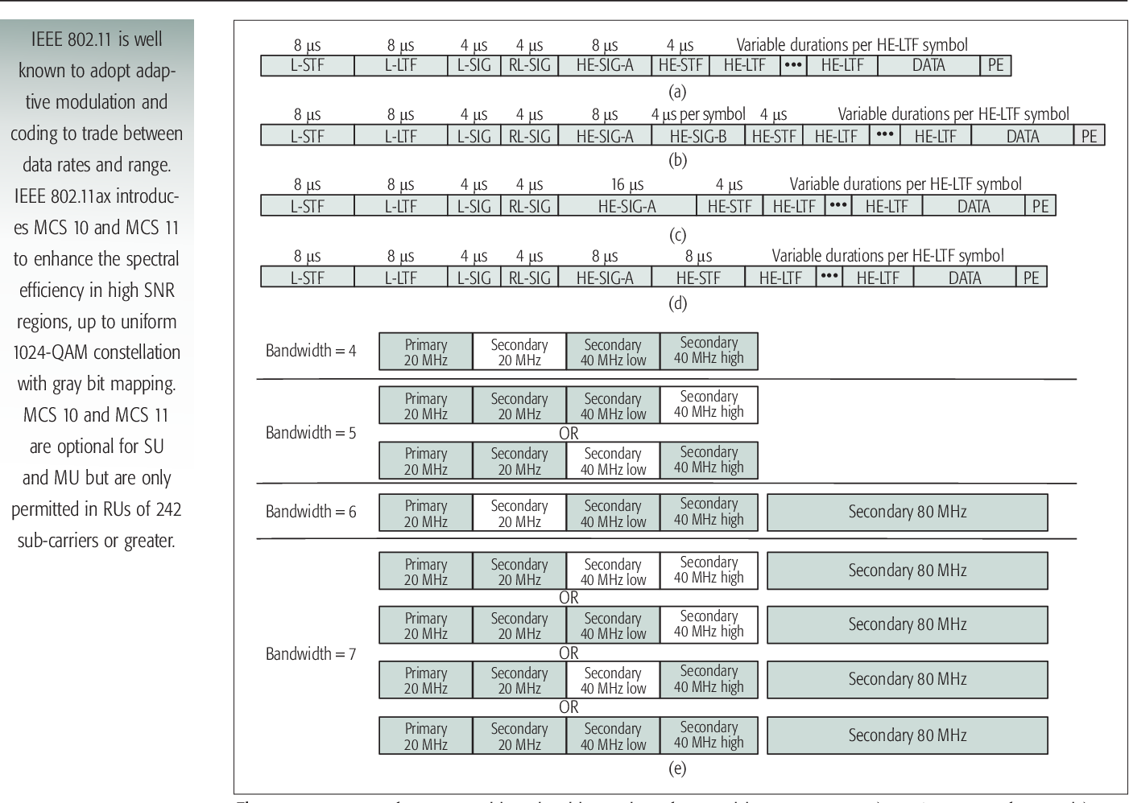
Extended Range Mode
Available for 802.11ax, 802.11bd
Preamble power-boosting up to 3 db
HE SU PPDU Format
HE Extended Range SU PPDU Format
Notes:
Preamble detection failure usually first
Packet discarded
Possible for Wifi 6 and IEEE 802.11bd
Only for MCS 0 – 2
Binary Phase shift keying coding rate of ½
20 Mhz and 1 Nss

Slide 13
Bandwidth in 5 GHz Frequency Range
Wi-Fi Standard | Bandwidth | Transmission Power Extend for transmission power CSX
802.11 p, 802.11bd | 10 MHz | 33 dbm 802.11p, 802.11bd
802.11 bd, 802.11ax, 802.11ac | 20 MHz | 33 dbm 802.11bd 30 dBm 802.11ax, ac 50 mW / MHz
802.11ax, 802.11ac | 40 MHz | 25 mW / MHz
802.11ax, 802.11ac | 80 MHz | 12.5 mW / MHz
802.11ax | 80 + 80 MHz | 6.25 mW / MHz
802.11ax | 160 MHz | 6.25 mW / MHz
Notes:
1 Watt = 30 dbm
Minus 5 db antenna gain looking at 25 dbm

Slide 14
Range
Throughput
Robustness
Notes:
Modulation Coding Scheme
New Error correction codes
Transmission power
Any questions so far?
What is possible?
What do we need? How bad are shadowing effect multipath effects?
Dave Smart getting in touch with the chips companies?

Slide 15
Field Measurements

Slide 16
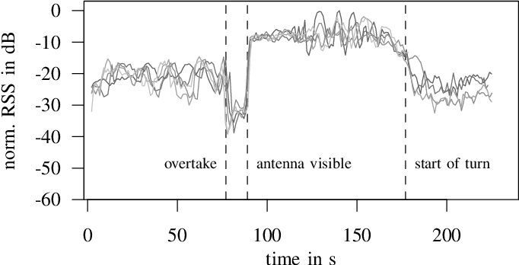
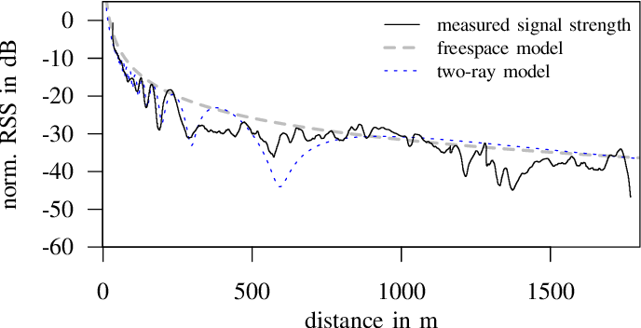
Motivation
Field Measurements
From F. Klingler, J. Blobel, and F. Dressler, “Agriculture meets IEEE 802.11p: A
Feasibility Study,” DOI: 10.1109/ISWCS.2018.8491239.
14
Notes:
Looking for a suitable technology,
No infrastructure Florian klingler mr blobel and falko dressler conducted field measurements in order to check the suitability of 802.11p for our agricultural domain.
Harvest szenarios
RSS is not as good as in other situations
Drop of RSS due to shadowing effects
<number>

Slide 17
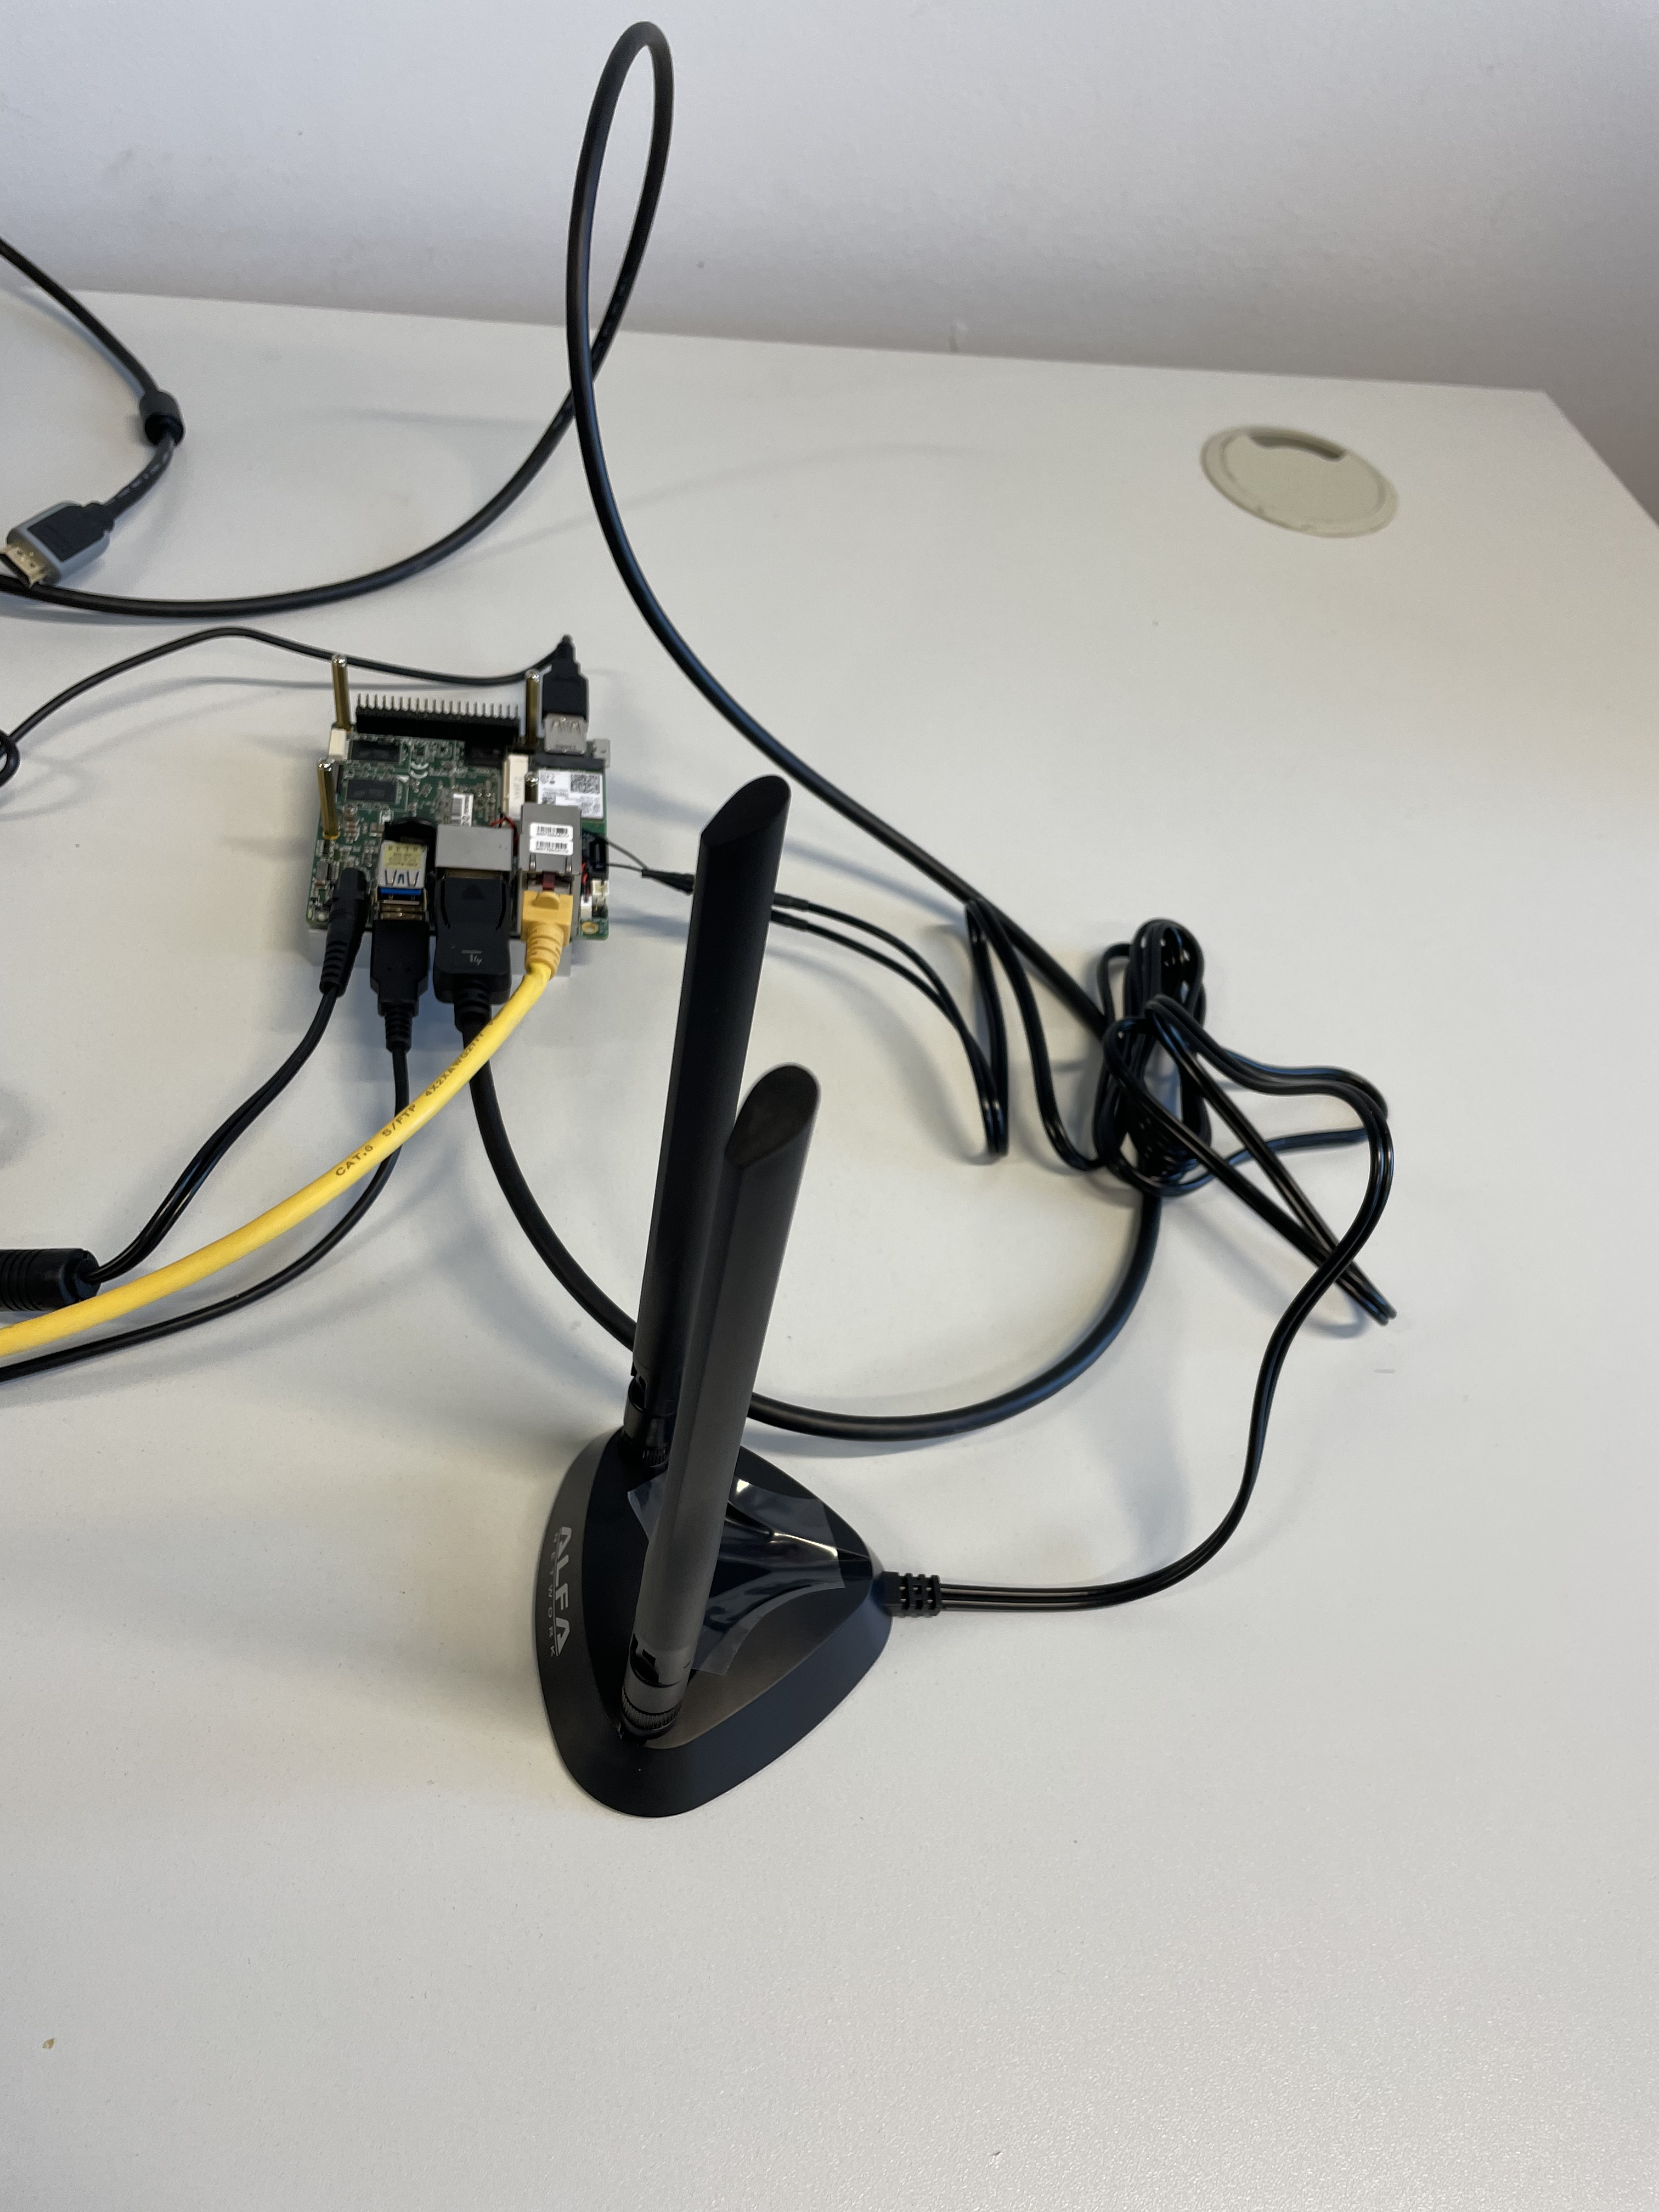
Field Measurements Equipment
Wi-Fi 6E Chips Intel AX210
Universal Software Radio Peripheral B 200
Industrial Router Milesight UR75
14
Notes:
RSSI ?
Uni two Mimo wifi 5 routers?
Use these?
But no STBC , DCM , Guard interval …
Implement Wi-Fi SDR s
<number>

Slide 18


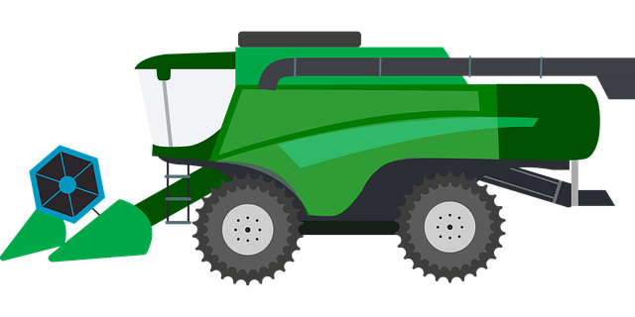

Field Experiments
communication range
14
Notes:
Communication range, latency.
Realistic agricultural maneuvers and study the signal propagation characteristics in this scenario
Place machine in certain angles and distances to each other and measure RSS
<number>

Slide 19
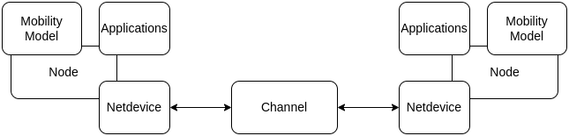
Network Simulation
Notes:
Ns3, Omnetpp Inet
MiniNet, Gns3
Matlab Toolboxes
Focussed on Ns3
Data Rate Ns3 Wifi 6 Application TCP UDP QoS , Priority Routing Protocols
Transmission range Effects DCM STBC GI usually Matlab

Slide 20
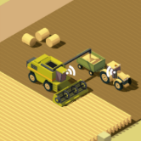
Simulation
Harvest Platooning Service
K. Lautenschlaeger, Suitability of IEEE 802.11ax \ IEEE 802.11ac for Wireless Infield-Communication
14
Notes:
Physical Layer amendment of Wifi 6
Longer Preamble for extended range
Next transporting machine waiting in line
Simulate such a system
3-5 Harvest Platoons on a field?
<number>

Slide 21
Simulation
Agricultural Platooning Service in Leader-Follower-Scenario
Follower_2
Follower_1
Leader
K. Lautenschlaeger, Suitability of IEEE 802.11ax \ IEEE 802.11ac for Wireless Infield-Communication
14
Notes:
<number>

Slide 22
Summary
Analyzing Telemetry data of Use Cases
required latency
required data Rate
required communication distance
Field measurements
communication range
received signal strength in agricultural scenarios
Latency
Simulation
Leader-Follower-Scenario
Harvest-Platoon-Scenario
K. Lautenschlaeger, Suitability of IEEE 802.11ax \ IEEE 802.11ac for Wireless Infield-Communication
14
Notes:
Recall interest in the topic Advice, recommendations,
Cooperate work together
Frame of a final thesis, support the group

Slide 23
Thanks!
Notes:
<number>
1/25/23

